Slide 1
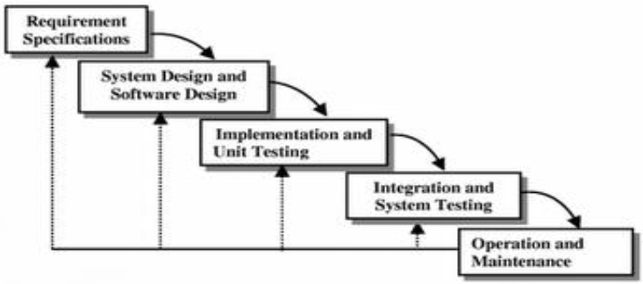
ITERATIVE WATERFALL MODEL
To overcome the major shortcomings of the classical waterfall model, we come
up with the iterative waterfall model.
Here, this model provide feedback paths for error correction as & when detected
later in a phase.
Though errors are inevitable, but it is desirable to detect them in the same phase in
which they occur.
If so, this can reduce the effort to correct the bug.

Slide 2
The advantage of this model is that there is a working model of the system at a very
early stage of development which makes it easier to find functional or design flaws.
Finding issues at an early stage of development enables to take corrective measures in
a limited budget.
The disadvantage with this SDLC model is that it is applicable only to large and
bulky software development projects.
This is because it is hard to break a small software system into further small
serviceable increments/modules.

Slide 3
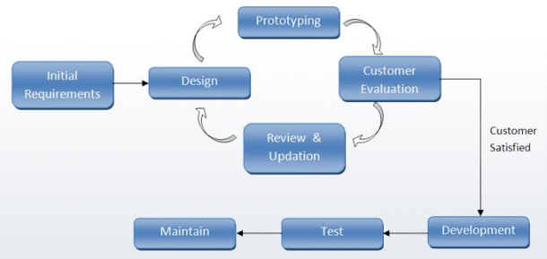
Prototyping Model
A prototype is a toy implementation of the system.
A prototype usually exhibits limited functional capabilities, low reliability, and
inefficient performance compared to the actual software.
A prototype is usually built using several shortcuts.
The shortcuts might involve using inefficient, inaccurate, or dummy functions.
The shortcut implementation of a function, for example, may produce the desired
results by using a table look-up instead of performing the actual computations.
A prototype usually turns out to be a very crude version of the actual system.

Slide 4
Need for a prototype in software development
There are several uses of a prototype. An important purpose is to illustrate the input
data formats, messages, reports, and the interactive dialogues to the customer.
This is a valuable mechanism for gaining better understanding of the customer’s
needs:
how the screens might look like
how the user interface would behave
how the system would produce outputs
Another reason for developing a prototype is that it is impossible to get the perfect
product in the first attempt.
Many researchers and engineers advocate that if you want to develop a good product
you must plan to throw away the first version.
The experience gained in developing the prototype can be used to develop the final
product.

Slide 5
A prototyping model can be used when technical solutions are unclear to the
development team.
A developed prototype can help engineers to critically examine the technical issues associated with the product development.
Often, major design decisions depend on issues like the response time of a hardware
controller, or the efficiency of a sorting algorithm, etc.
In such circumstances, a prototype may be the best or the only way to resolve the
technical issues.
A prototype of the actual product is preferred in situations such as:
User requirements are not complete
Technical issues are not clear

Slide 6
Example 1: User requirements are not complete
In any application software like billing in a retail shop, accounting in a firm, etc the
users of the software are not clear about the different functionalities required.
Once they are provided with the prototype implementation, they can try to use it and
find out the missing functionalities.
Example 2: Technical issues are not clear
Suppose a project involves writing a compiler and the development team has never
written a compiler.
In such a case, the team can consider a simple language, try to build a compiler in
order to check the issues that arise in the process and resolve them.
After successfully building a small compiler (prototype), they would extend it to one
that supports a complete language.

Slide 7
EVOLUTIONARY MODEL
It is also called successive versions model or incremental model.
At first, a simple working model is built.
Subsequently it undergoes functional improvements & keep on adding new
functions till the desired system is built.
Large projects where you can easily find modules for incremental implementation.
Often used when the customer wants to start using the core features rather than
waiting for the full software.
Also used in object oriented software development because the system can be easily portioned into units in terms of objects.
User gets a chance to experiment partially developed system
Reduce the error because the core modules get tested thoroughly.
It is difficult to divide the problem into several versions that would be acceptable to
the customer which can be incrementally implemented & delivered.

Slide 8
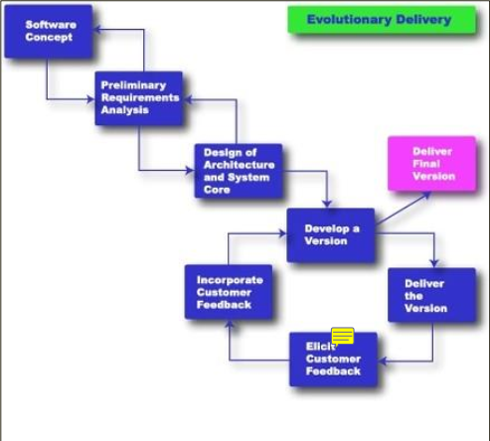
Fig : Evolutionary Model

Slide 9
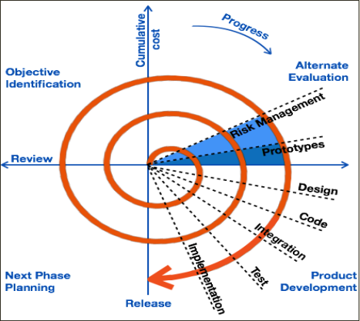
SPIRAL MODEL
The Spiral model of software development is shown in figure.
The diagrammatic representation of this model appears like a spiral with many loops.
The exact number of loops in the spiral is not fixed.
Each loop of the spiral represents a phase of the software process.
For example, the innermost loop might be concerned with feasibility study, the next
loop with requirements specification, the next one with design, and so on.
Each phase in this model is split into four sectors (or quadrants) as shown in figure.
The following activities are carried out during each phase of a spiral model.
Fig: Spiral Model

Slide 10
First quadrant (Objective Setting) • During the first quadrant, it is needed to identify the objectives of the phase. • Examine the risks associated with these objectives.
Second Quadrant (Risk Assessment and Reduction) • A detailed analysis is carried out for each identified project risk. • Steps are taken to reduce the risks.
For example, if there is a risk that the requirements
are inappropriate, a prototype system may be developed.
Third Quadrant (Development and Validation) • Develop and validate the next level of the product after resolving the identified risks.
Fourth Quadrant (Review and Planning) • Review the results achieved so far with the customer and plan the next iteration round
the spiral. • Progressively more complete version of the software gets built with each iteration around the spiral.

Slide 11
Circumstances to use spiral model
The spiral model is called a meta model since it encompasses all other life cycle
models.
Risk handling is inherently built into this model.
The spiral model is suitable for development of technically challenging software
products that are prone to several kinds of risks.
However, this model is much more complex than the other models – this is probably a
factor deterring its use in ordinary projects.

